Slide 1

EMPLOYEE PRODUCTIVITY AND SATISFACTION REPORT
BY TEAM ALPHA
Ngozi Okeychukwu
Matthias Onidoma
Saheed Badmus
Esther Ugwu
Karimat Oyetola
Ukamaka Olaitan
Augustine Ogbonnah
JULY 18TH,2024.

Slide 2
Situation
INTRODUCTION
High turnover rates and inconsistent employee performance are critical issues that jeopardize organizational efficiency and profitability. These challenges lead to increased recruitment and training costs, disruption of workflows, and decreased employee morale. To create a conducive work environment that fosters high performance and retention, it is essential to understand the determinants of employee productivity and satisfaction. By identifying these key factors, organizations can implement targeted strategies to mitigate these issues and enhance employee engagement and productivity.
Notes:
Our Organization is faced with rising high employee turnover rate, inconsistent performance and low efficiency resulting in low profitability. Mgt has requested that using data analysis we can identify the factors affecting job satisfaction and productivity and to suggest strategies to mitigate the issues faced by the company.

Slide 3
Task
1. Identify Key Factors Influencing Employee Productivity and Satisfaction:
Analyze data from multiple sources to pinpoint specific factors that significantly impact employee performance and job satisfaction.
2. Develop Data-Driven Insights:
Utilize advanced analytics techniques to generate deep insights into the relationships between various factors affecting employee productivity and satisfaction.
3. Recommend Strategies to Improve Employee Satisfaction and Productivity:
Formulate strategic recommendations based on the insights derived, aimed at enhancing employee satisfaction and productivity to improve overall organizational performance.
4. Prepare a Comprehensive Report of Analysis:
Compile a detailed report that presents the findings of the analysis, insights, and recommended strategies, serving as a valuable resource for organizational decision-makers.
Notes:
The primary objectives of this project are as follows:

Slide 4
Task
5. Expected Outcomes
By the end of this project, we expect to have a comprehensive understanding of the factors influencing employee productivity and satisfaction. The insights derived will inform strategic decisions aimed at enhancing job satisfaction and performance. This will contribute to a more efficient, productive, and satisfied workforce, ultimately leading to improved organizational performance and reduced turnover rates.
The project also aims to provide immediate insights and actionable recommendations, as well as establish a foundation for continuous improvement in managing employee productivity and satisfaction. Through ongoing data analysis and strategic implementation, the organization can foster a positive work environment that supports both employee well-being and organizational success.
Data Collection and Processing:
Our data is from internal sources, including employee records, performance evaluations, engagement surveys, and operational metrics. Data Cleaning and Preparation was done by searching for null values, mis-matched data etc. to ensure data accuracy and consistency by addressing missing values, outliers, and inconsistencies.

Slide 5
Action
Exploratory Data Analysis (EDA):
We performed a comprehensive Exploratory Data Analysis (EDA) of our dataset. This helped us uncover valuable insights related to employee productivity and satisfaction.
Key Observations
(a). The Company experienced sever employee exits during the review period representing 85.2% of total workers.
(b). There are negative relationships between the variables in the dataset. Some have weak relationships, while some are strong.
(c). Average % Job Satisfaction Rate across the departments which is indicated by the rate of exit and reasons for exit.

Slide 6
Action
(d) Technology usage did not significantly impact efficiency and output. Employee efficiency was highest at 32.26% with Technology Utilization Score of 10
(e) Employees of both gender between the ages of 40 – 59 were the highest performances.
(f) Career change and higher salary were the most important reasons for employees exiting the company.
Methodology:
We employed Tableau to generate the visualization and data analysis.

Slide 7
Result
Identified Key Factors Influencing Employee Productivity and Satisfaction:
Work Environment Communication Resources and Tools Motivation and Rewards Leadership and Management Training and Skill Development Work-Life Balance Positive Work Culture Compensation and Benefits | Career Growth Opportunities Autonomy and Empowerment Recognition and Feedback Workload and Stress Management Diversity and Inclusion Health and Well-being Programs Technology and Innovation Company Values and Purpose
Notes:
Though we identified 17 key factors influencing Employee productivity and satisfaction, we focused on 4 factors that we think captured the situation the Company is facing.

Slide 8
Result
FACTORS FOCUSED ON IN THIS REPORT AND WHY
1. Employee Job satisfaction:
This measure reflects the overall satisfaction of employees with their job, considering various satisfaction metrics.
2. Employee Job Performance:
This measure reflects the overall performance of employees, combining factors like quality of work, completion rates, and other performance metrics.
3. Engagement and Participation
This measure captures how engaged and participative employees are in various activities, which often correlates with job satisfaction and productivity.
4. Technology Utilization
This measure assesses how effectively employees are using technology to enhance their productivity.

Slide 9
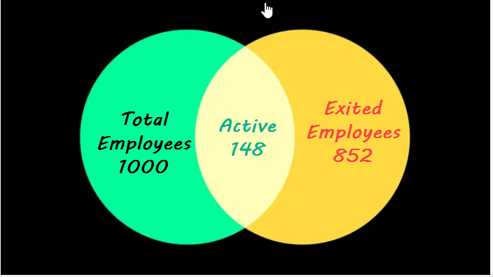
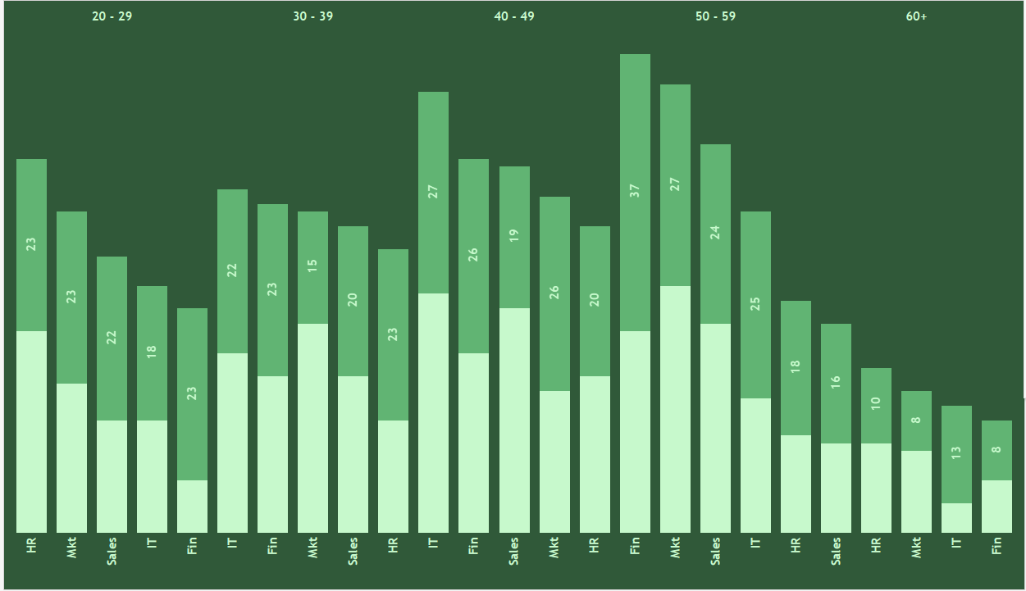
Result
Employees Distribution
During the period under review, a total of 1000 employees worked for the Company. Active Employees as at today is 148 ( 75 females and 73 Males)
The age distribution of all employees and their departments by gender is shown below.
Its important to note that the company had employed more female that male

Slide 10
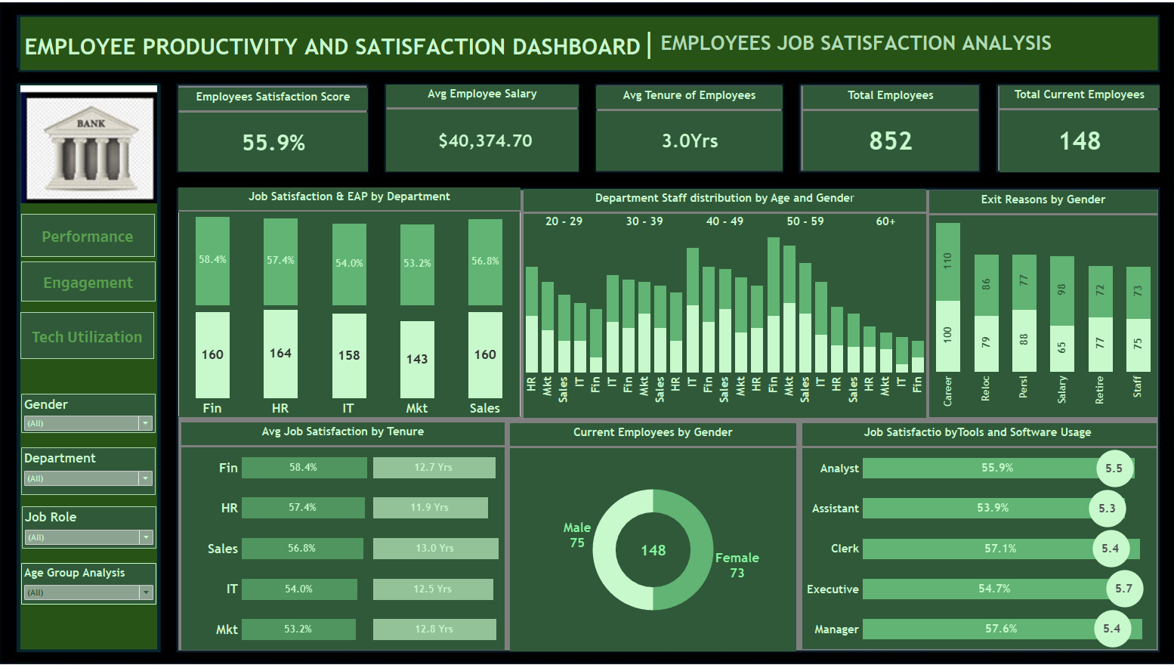

Slide 11
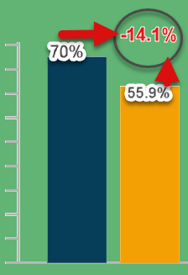
Result
Insights
Job Satisfaction Analysis
Average Job Satisfaction by Department:
Avg Score = 55.9%
Finance is 58.4% (Highest Score), Mkt is 53.2% (Lowest Score)
Correlation with Tenure:
Longer Tenure is NOT associated with Job Satisfaction. Highest tenure – 13yrs with Job Satisfaction of 56.8% in Sales Dept
Impact of Salary:
The trend line slopes upwards, indicating a weak positive relationship between salary and job satisfaction. At a salary of $54,668, the Job Satisfaction score is 70%. Thus as the salary increases the average job satisfaction increases too.
Strategies:
Focus on improving conditions in departments with low satisfaction scores.
Implement policies that address the needs of employees with longer tenure.
Consider salary adjustments to enhance job satisfaction.
( (US Bureau of Labor Statistics)
Notes:
Companies that want to get serious about improving job satisfaction should start by listening to employees. That way, they can learn about the issues that matter to employees, the resources they need to do their jobs better and their ideas for how the organization’s culture can improve.

Slide 12
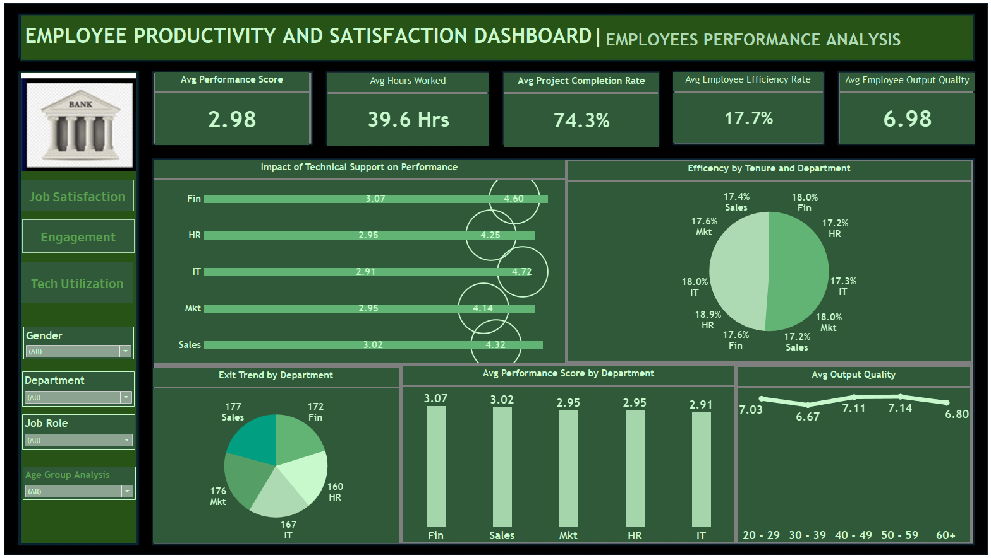

Slide 13
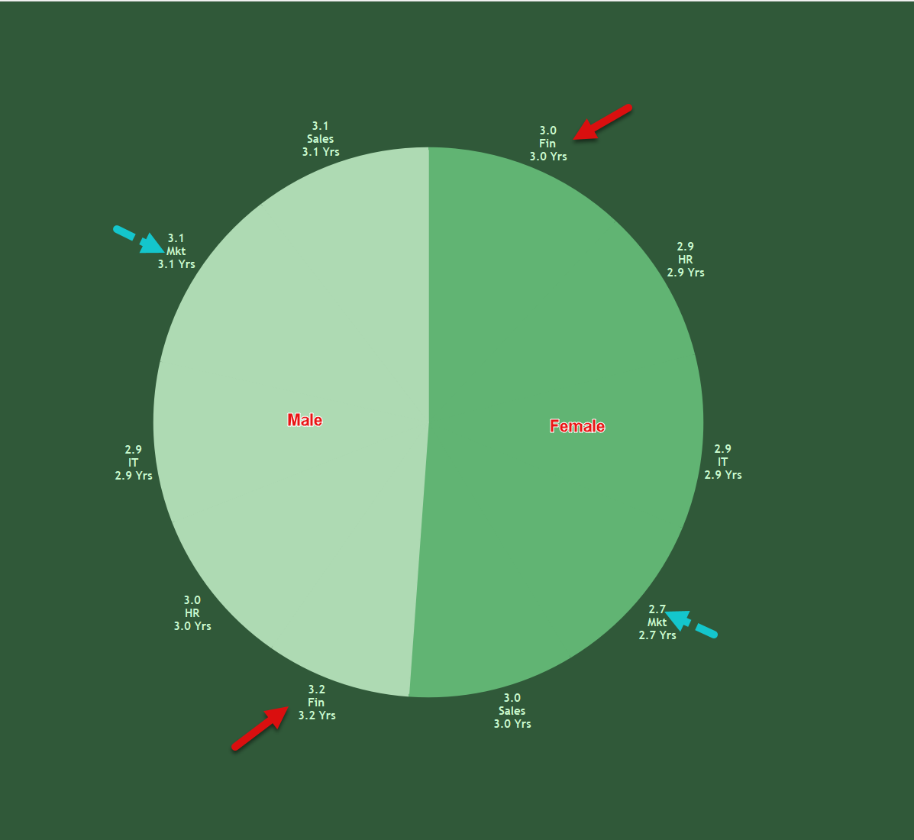
Result
Insights:
1. Average Performance Scores by Department
Avg Performance Score – 2.98
Finance – 3.07 (Highest)
IT – 2.91(Lowest)
2. Hours Worked vs. Performance
Hours worked has no significant positive relationship with Performance
Longer hours worked did not result in higher performance.
Output Quality was highest from Age group 40 - 59
3. Impact of System Downtime:
System downtime did not affect employee performance.
Marketing and Finance departments were least affected by system downtime.
Technical support significantly impacted performance in IT and Finance.
4. Strategies:
Provide additional support and resources to departments with lower performance.
Optimize work hours to ensure a balance between productivity and burnout.
Invest in improving system reliability to minimize downtime.

Slide 14
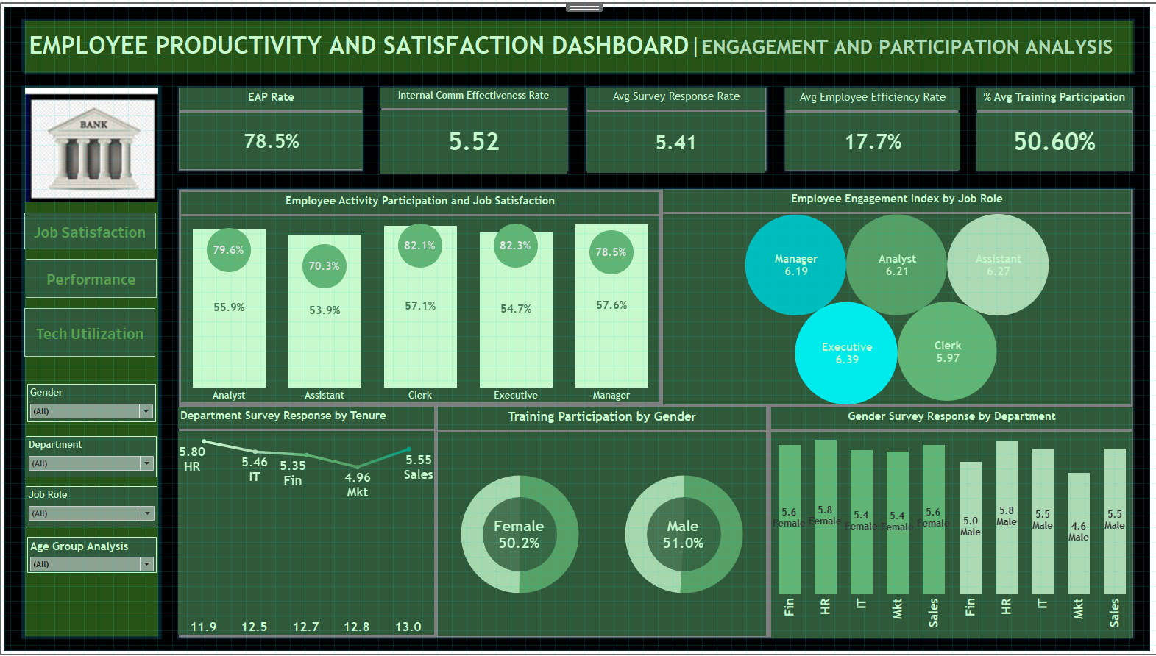
Notes:
Engaged employees are the key to a successful business. That’s the short answer to the question, “Why is employee engagement important?”

Slide 15

Result
3. Employee Engagement and Participation
Insights:
Engagement Activity Participation by Department:
Avg EAP == 78.5%
Mktg has the lowest EAP = 68.1%
Survey Response Analysis:
Survey response – Mktg – 5.4 (Female) 4.6(Male).
Training Participation – 43.6%(female) 49.1% (Male) Lowest
Impact on Performance and Satisfaction:
EAP high though Job Satisfaction is moderate
Higher EAP does not result in higher Job Satisfaction across board.
Strategies:
Encourage participation in engagement activities through incentives and recognition.
Improve survey designs and follow-up to increase response rates.
Foster a culture of participation to enhance overall engagement and performance.
:
Notes:
Engaged employees are the key to a successful business. That’s the short answer to the question, “Why is employee engagement important?”
When your employees are engaged and driven by the work they do, your whole organization will be more productive and reach goals faster. They’re also more likely to stay at your company if they feel connected and empowered in their roles, reducing recruiting expenses.
A major driver of employee engagement is understanding how individual roles contribute to business strategy and objectives. If employees feel like their work has meaning and they’re valued by an organization, they’ll be more inclined to work harder.

Slide 16
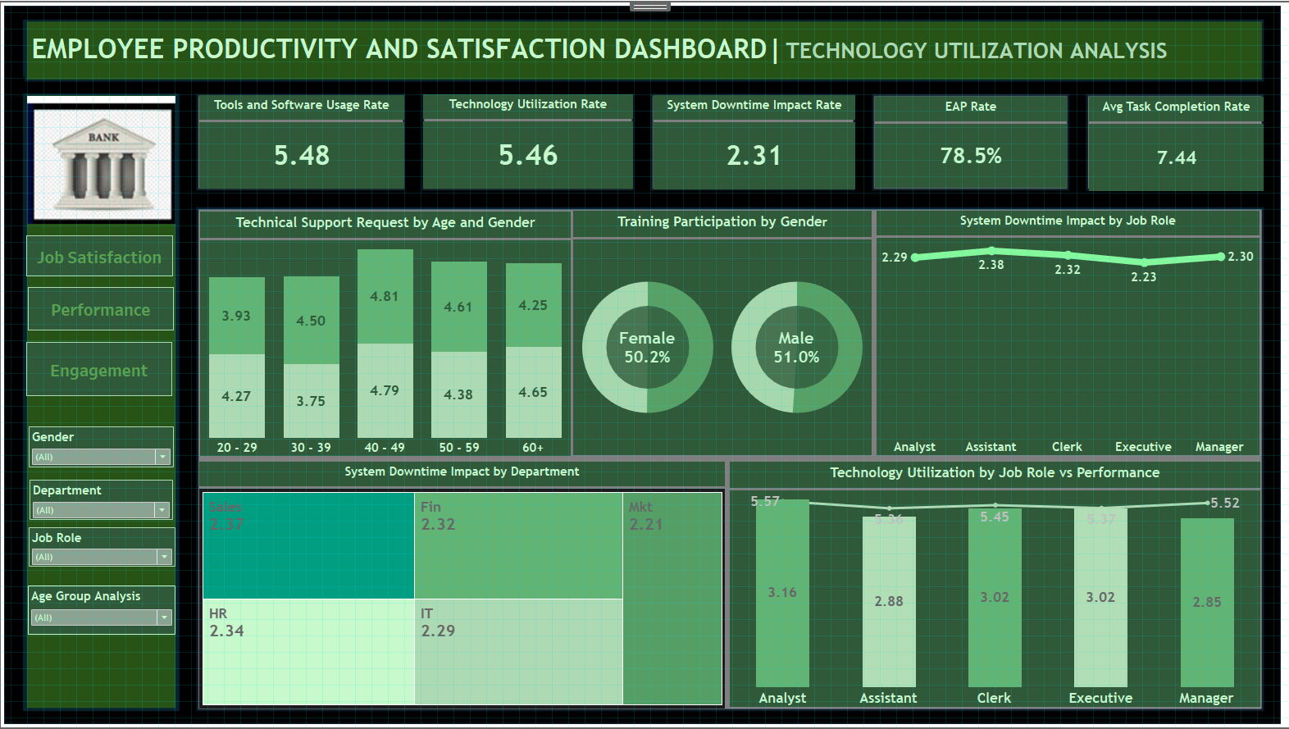

Slide 17
Result
4. Technology Utilization
Insights:
Technology Utilization by Department:
Avg 5.46 or 54.6% / 2.31 System Downtime
IT Dept has highest rate of 5.86 / 2.29 System downtime
Finance Dept has the lowest of 5.07 / 2.32 System downtime
Impact of Technical Support Requests:
Across all departments there were high technical support requests, especially from Sales.
Finance Dept has high technical utilization with moderate performance. Tools and Software usage was 5.55
Higher support needs indicate lower technology proficiency.
Correlation with Performance:
High technology utilization only resulted in moderate employee performance between 2.85 – 3.16
No better technology use correlates with higher performance scores.
Strategies:
Provide training and support to departments with low technology utilization.
Streamline technical support processes to improve efficiency and reduce downtime.
Encourage the use of technology tools that enhance productivity.

Slide 18
Recommendations
Based on the insights derived from the analysis, the following strategic recommendations are proposed:
1. Enhance Training and Feedback:
Regularly review and update training programs to ensure they are relevant to current job roles.
Solicit feedback from employees to continuously improve the training content and delivery methods.
2. Promote Work-Life Balance:
Implement flexible work arrangements, including remote work options and flexible hours, to help employees achieve a better work-life balance. This will not only improve job satisfaction but also enhance overall productivity.

Slide 19
Recommendations
3. Strengthen Engagement and Communication:
Encourage regular feedback and recognition programs to sustain high levels of engagement and participation. Foster a culture of open communication and continuous improvement to address employee concerns promptly.
4. Optimize Technology Utilization:
Implement proactive maintenance schedules and backup solutions to reduce system downtime. Encourage departments to share successful technology utilization strategies to improve efficiency across the organization.

Slide 20
Future Work
To build on the findings of this analysis, future research should focus on:
1. Evaluating the long-term impact of training programs on employee performance and satisfaction.
2. Assessing the effectiveness of work-life balance initiatives on reducing turnover rates.
3. Exploring the correlation between engagement activities and employee retention.
4. Investigating the role of technology in enhancing employee productivity in different job roles and departments.

Slide 21
Conclusion
Key Findings
1. Compensation and Benefits
Salary is a very important determinant of employee satisfaction and performance. The Company needs to review its compensation policy urgently. The desire for higher salary accounted for a significant number of exited employees particularly female workers. On average employees earn as little as $20.83/hour.
2. Training Programs:
Effective training programs are crucial for boosting both employee performance and job satisfaction. Aligning training content with job roles and gathering employee feedback on its relevance and impact are essential steps for continuous improvement.
3. Work-Life Balance:
Promoting work-life balance through remote work options and flexible hours significantly enhances job satisfaction, particularly in departments like Marketing. These initiatives help employees manage their personal and professional lives more effectively, leading to higher morale and productivity.
4. Engagement and Participation:
Regular engagement activities and effective internal communication are vital for maintaining high levels of employee participation and satisfaction. Departments with proactive engagement strategies tend to have higher performance scores and lower turnover rates.
5. Technology Utilization:
Efficient use of technology tools and minimizing system downtime are critical for maintaining high productivity levels. Implementing proactive maintenance schedules and sharing best practices across departments can lead to more effective technology utilization.

Slide 22
Conclusion
By addressing the identified areas for improvement and implementing the recommended strategies, the organization can create a more conducive work environment that fosters high performance, job satisfaction, and retention. Continuous monitoring and analysis will ensure that the organization remains responsive to employee needs and can adapt to changing conditions, ultimately driving sustained success and growth.

Slide 23
THANK YOU

